Slide 1
Data Structures
ICT-1211
Information and Communication Technology
Lecture-20
Date: //2024

Slide 2
Stacks, Queues, Recursion

Slide 3
Recursion: Function
For certain problems (such as the factorial function), a recursive solution often leads to short and elegant code. Compare the recursive solution with the iterative solution:
Iterative solution
int fac(int numb){
int product=1;
while(numb>1){
product *= numb;
numb--;
}
return product;
}
Recursive solution
int fac(int numb){
if(numb<=1)
return 1;
else
return numb*fac(numb-1);
}

Slide 4
Recursion: Cost
You have to pay a price for recursion:
  Calling a function CONSUMES MORE TIME AND MEMORY than adjusting a loop counter.
  High performance applications (graphic action games, simulations of nuclear explosions) hardly ever use recursion.
In LESS DEMANDING APPLICATIONS recursion is an attractive alternative for iteration.

Slide 5
Recursion: Precautions
You must always make sure that the recursion bottoms out:
A recursive function must contain at least one non-recursive branch.
The recursive calls must eventually lead to a non-recursive branch.
int fac(int numb){
if(numb<=1)
return 1;
else
return numb * fac(numb-1);
}

Slide 6
Recursion: Function
How many pairs of rabbits can be produced from a single pair in a year's time?
Assumptions:
  Each pair of rabbits produces a new pair of offspring every month;
  each new pair becomes fertile at the age of one month;
  none of the rabbits dies in that year.
Example:
  After 1 month there will be 2 pairs of rabbits;
  after 2 months, there will be 3 pairs;
  after 3 months, there will be 5 pairs (since the following month the original pair and the pair born during the first month will both produce a new pair and there will be 5 in all).

Slide 7
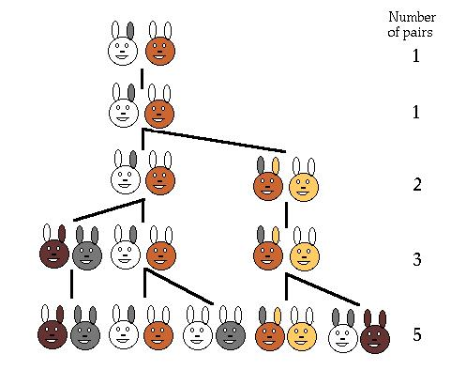
Recursion: Function
Population Growth in Nature
Leonardo Pisano (Leonardo Fibonacci, son of Bonaccio) proposed the (Fibonacci) sequence in 1202 in The Book of the Abacus.
Fibonacci numbers are believed to model nature to a certain extent, such as Kepler's observation of leaves and flowers in 1611.

Slide 8
Recursion: Function
Direct Computation Method
Fibonacci numbers:
  0, 1, 1, 2, 3, 5, 8, 13, 21, 34, ...
where each number is the sum of the preceding two.
Recursive definition:
  F(0) = 0;
  F(1) = 1;
  F(number) = F(number-1)+ F(number-2);

Slide 9
Recursion: Function
// Calculate Fibonacci numbers using recursive function.
// A very inefficient way, but illustrates recursion well
int fib(int number)
{
if (number == 0) return 0;
if (number == 1) return 1;
return (fib(number-1) + fib(number-2));
}
int main(){ // driver function
int inp_number;
printf("Please enter an integer: ”);
scanf(“%d”&inp_number);
cout << "The Fibonacci number for "<< inp_number
<< " is "<< fib(inp_number)<<endl;
return 0;
}
Recursive definition:
F(0) = 0;
F(1) = 1;
F(number)=F(number-1)+ F(number-2);

Slide 10
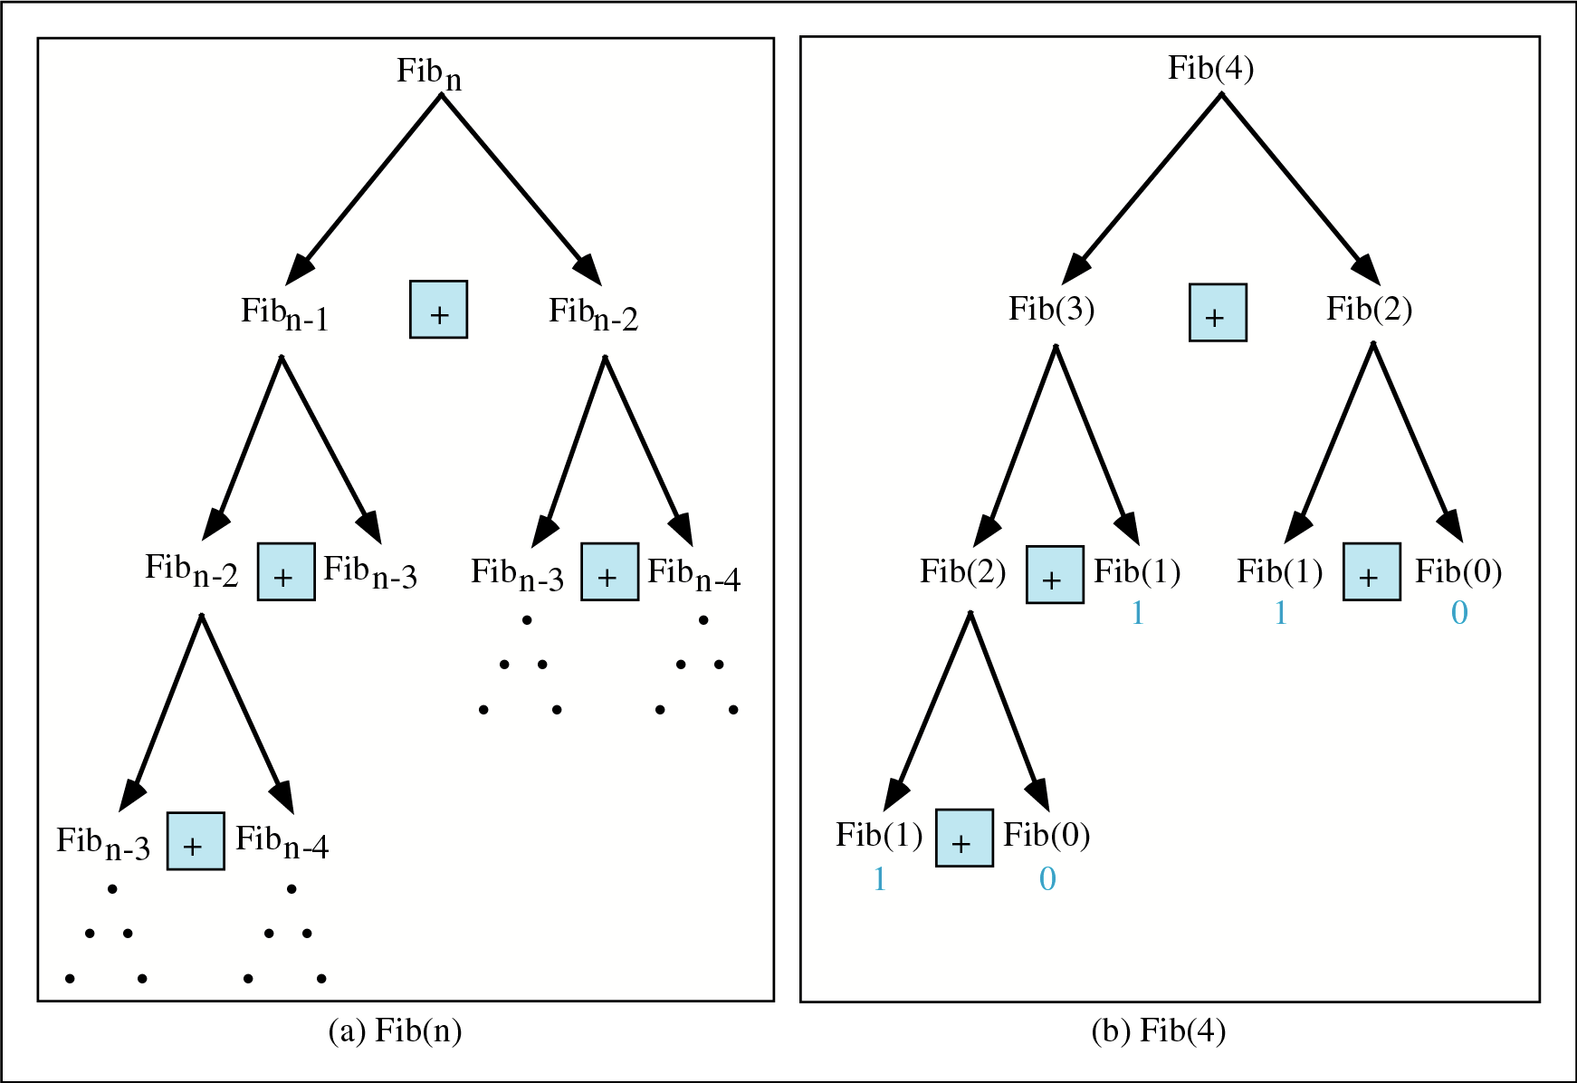
Recursion: Fibbonacci

Slide 11
Recursion: Trace a Fibonacci Number
int fib(int num)
{
if (num == 0) return 0;
if (num == 1) return 1;
return
(fib(num-1)+fib(num-2));
}
Assume the input number is 4, that is, num=4:
fib(4):
  4 == 0 ? No; 4 == 1? No.
  fib(4) = fib(3) + fib(2)
  fib(3):
    3 == 0 ? No; 3 == 1? No.
    fib(3) = fib(2) + fib(1)
    fib(2):
      2 == 0? No; 2==1? No.
      fib(2) = fib(1)+fib(0)
    fib(1):
    1== 0 ? No; 1 == 1? Yes.
    fib(1) = 1;
    return fib(1);

Slide 12
Recursion: Trace a Fibonacci Number
fib(0):
    0 == 0 ? Yes.
    fib(0) = 0;
    return fib(0);
    fib(2) = 1 + 0 = 1;
    return fib(2);
  fib(3) = 1 + fib(1)
fib(1):
    1 == 0 ? No; 1 == 1? Yes
    fib(1) = 1;
    return fib(1);
  fib(3) = 1 + 1 = 2;
  return fib(3)

Slide 13
Recursion:
fib(2):
      2 == 0 ? No; 2 == 1? No.
      fib(2) = fib(1) + fib(0)
      fib(1):
    1== 0 ? No; 1 == 1? Yes.
    fib(1) = 1;
    return fib(1);
    fib(0):
    0 == 0 ? Yes.
    fib(0) = 0;
    return fib(0);
    fib(2) = 1 + 0 = 1;
    return fib(2);
  fib(4) = fib(3) + fib(2)
  = 2 + 1 = 3;
  return fib(4);

Slide 14
Recursion: Divide-and-Conquer Algorithms
Consider a problem P associated with a set S.
Suppose A is an algorithm which partitions S into smaller sets such that the solution of the problem P for S is reduced to the solution of P for one or more of the smaller sets.
Then A is called a divide-and-conquer Algorithm.
Examples:
The Quicksort Algorithm
-use reduction step to find the location of a single element and to reduce the problem of sorting the entire set to the problem of sorting smaller sets
The Binary Search Algorithm
-divides the given sorted set into two halves so that the problem of searching for an item in the entire set is reduced to the problem of searching for the item in one of the two halves.

Slide 15
Recursion: Divide-and-Conquer Algorithms
A divide-and-conquer algorithm A may be viewed as a recursive procedure. But Why?
    The divide-and-conquer algorithm A may be viewed as calling itself when it is applied to the smaller sets.
    The base criteria for these algorithms are usually the one-element sets.
    For example, with a sorting algorithm, a one-element set is automatically sorted, and
    with a searching algorithm, one-element set requires only a single comparison.

Slide 16
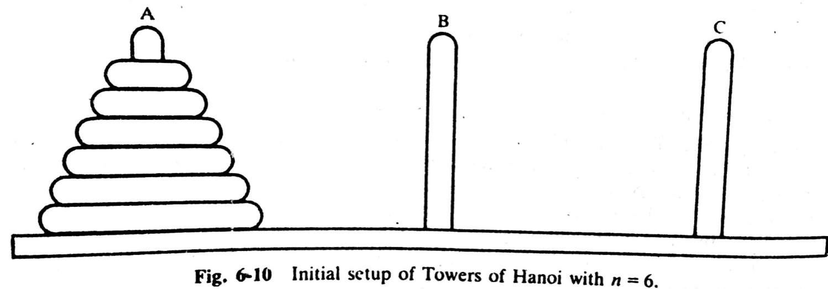
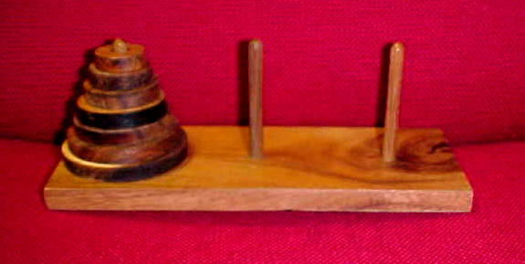
TOWER of HANOI Problem
Notes:
The preceding section gave examples of some recursive definition and procedures. Recursion may be used as a tool in developing an algorithm to solve a particular problem. The problem we pick is known as Tower of Hanoi problem.

Slide 17
TOWER of HANOI Problem
  Only one disc could be moved at a time
  A larger disc must never be stacked above a smaller one
  One and only one extra needle could be used for intermediate storage of discs
Notes:
The preceding section gave examples of some recursive definition and procedures. Recursion may be used as a tool in developing an algorithm to solve a particular problem. The problem we pick is known as Tower of Hanoi problem.

Slide 18
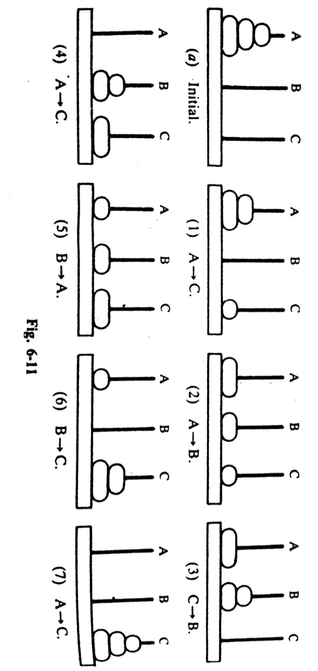
TOWER of HANOI Problem Solution
The solution to the Tower of Hanoi problem for n=3 appears
N=3: A→C, A→B, C→B, A→C, B→A, B→C, A→C,
Notes:
The preceding section gave examples of some recursive definition and procedures. Recursion may be used as a tool in developing an algorithm to solve a particular problem. The problem we pick is known as Tower of Hanoi problem.

Slide 19
TOWER of HANOI Problem Solution
The SEPARATE SOLUTION to the Tower of Hanoi problem
for n=1
Solution: A→C
n=2
Solution: A→B, A→C, B→C
n=3
Solution: A→C, A→B, C→B, A→C, B→A, B→C, A→C
General Solution to the Tower of Hanoi for any # of Disk is PREFERRED.
Which can be done in RECURSIVE way.
Notes:
The preceding section gave examples of some recursive definition and procedures. Recursion may be used as a tool in developing an algorithm to solve a particular problem. The problem we pick is known as Tower of Hanoi problem.

Slide 20
Thank you……

